Slide 1
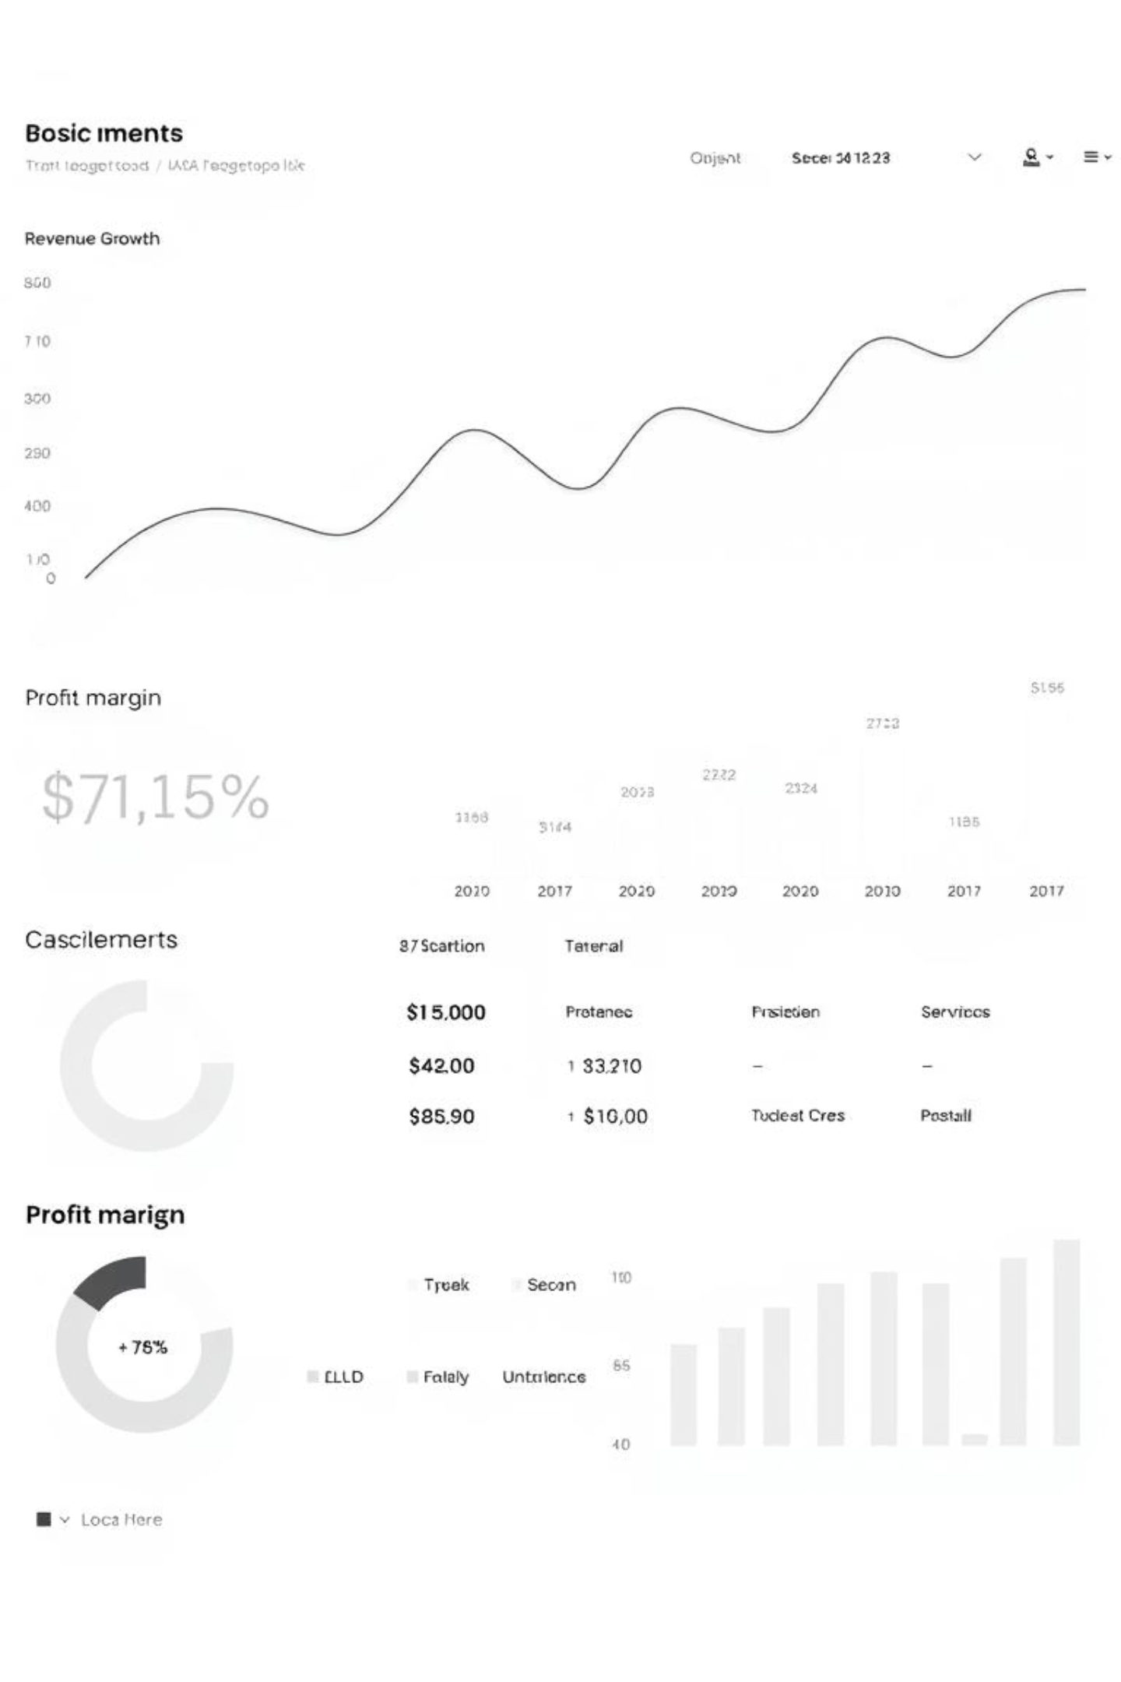
MoneyMap: Agile & Kanban for Visual Budget & Expense Tracker
Welcome to our presentation on the MoneyMap project. We're excited to share how the Agile methodology and Kanban framework will drive our development of this intuitive visual budget and expense tracker.

Slide 2

Why Agile & Kanban for MoneyMap?
MoneyMap is designed to simplify financial management through visual budget tracking, expense categorization, and manual entry.
Our team—Ashim Gurung, Ayush Pun, and Sanjeel Gurung—will leverage Agile's iterative approach, especially for UI/UX, ensuring continuous customer feedback and adaptability to evolving user needs.

Slide 3




Agile Fundamentals: Values & Benefits
Iterative Development
Enables continuous refinement of UI/UX, delivering functional components rapidly.
Customer Collaboration
Integrates feedback early and often, ensuring features align with user needs.
Adaptability
Allows for flexible responses to changing requirements and market shifts.

Slide 4




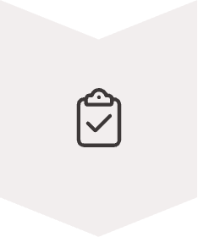
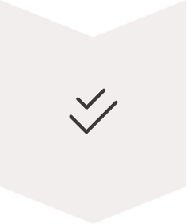
Kanban Framework: Visual Workflow
Backlog
Prioritized list of features and user stories, ready for development.
Analysis
Detailed breakdown of user stories and technical requirements.
Development
Coding and implementation of features.
Testing
Quality assurance and bug identification.
Review
Stakeholder feedback and acceptance.
Done
Completed and deployed features.

Slide 5
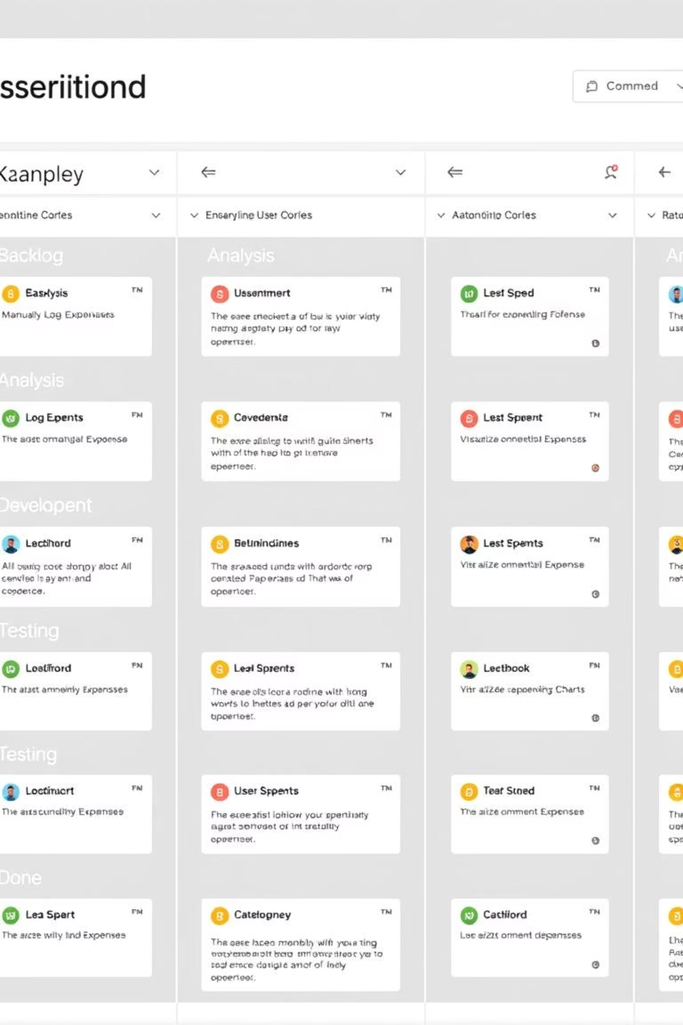
MoneyMap Kanban Board in Action
Our Kanban board visually tracks MoneyMap's progress, from "Backlog" to "Done." User stories like "As a user, I want to manually log expenses" move through "Analysis," "Development," "Testing," and "Review," ensuring a clear, continuous flow.

Slide 6
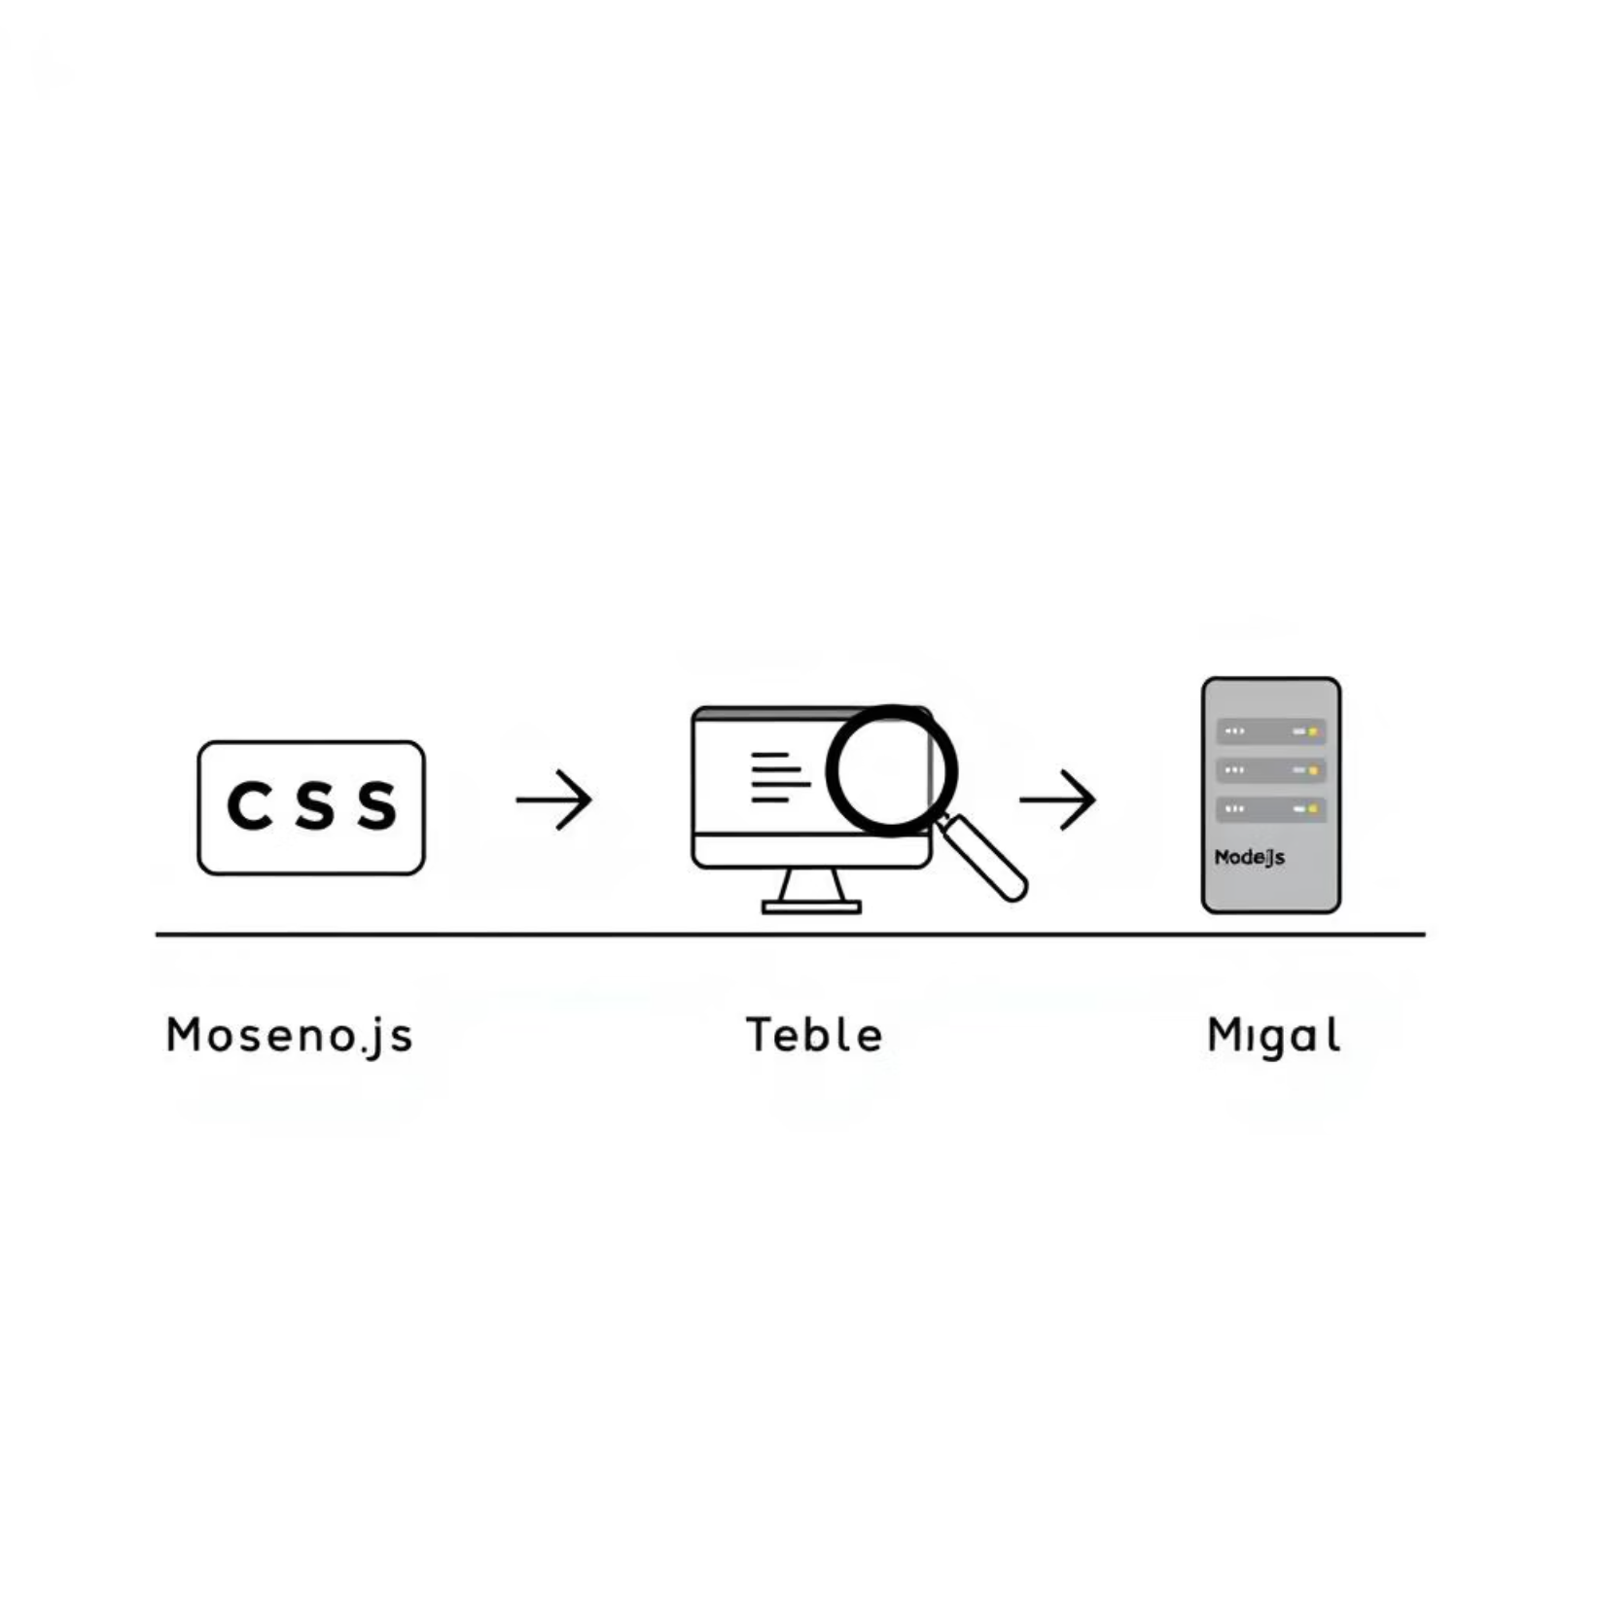
Continuous Delivery & Technology Stack
Our development workflow emphasizes continuous flow and a pull-based system. Daily standups ensure seamless coordination.
MoneyMap leverages HTML, CSS, JS for frontend, Node.js for backend, and MySQL for database management. This stack supports our continuous integration and testing.

Slide 7
Benefits & Potential Challenges
Benefits
Challenges
Faster user feedback on UI/UX
Academic project constraints and deadlines
Better handling of technical challenges
Team coordination across different tasks
Improved team collaboration and communication
Balancing Agile flexibility with structured requirements
Higher quality deliverables
Learning curve for new Agile practices

Slide 8

Conclusion & Next Steps
Agile & Kanban Synergy
Commitment & Flow
Workflow Initiation
Agile principles combined with Kanban's continuous flow will optimize MoneyMap's development.
Our team is committed to Kanban practices for efficient, high-quality delivery.
Next steps involve formalizing the Kanban board and initiating the first set of user stories.
Thank you. We are now open for any questions regarding our methodology and the MoneyMap project.

